Slide 1
GM MAS PharmOutcomes Modules Overview
September 2020
Alison Scowcroft (CHL)

Slide 2
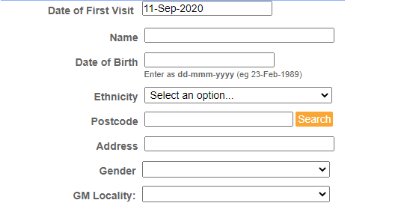
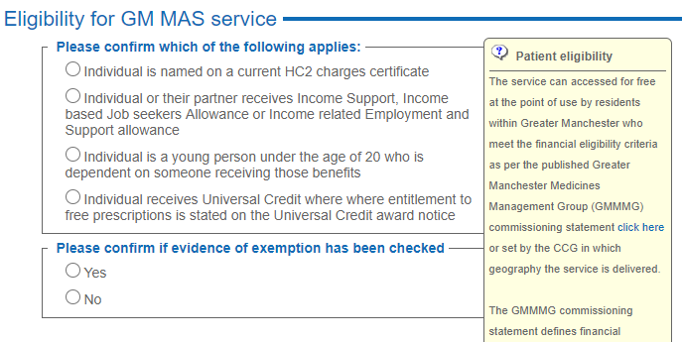
Patient Registration
Register the patient before providing a consultation
Register once only
Eligibility as per GMMMG commissioning statement (all areas except Salford)

Slide 3
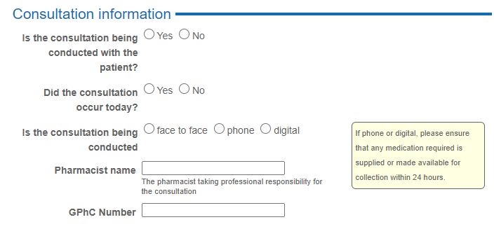
Supply (1) Consultation Info
Select patient – links back to registration module, cannot add a new patient at this point
Select GM locality & confirm eligibility as in registration module
Complete consultation information

Slide 4
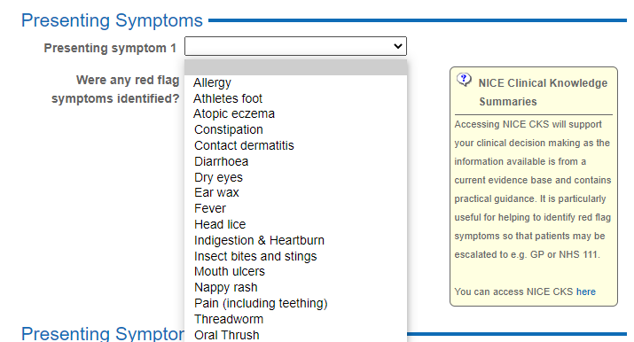
Supply (2) Presenting Symptoms
Select the presenting symptom
Check for red flags
Link to CKS

Slide 5
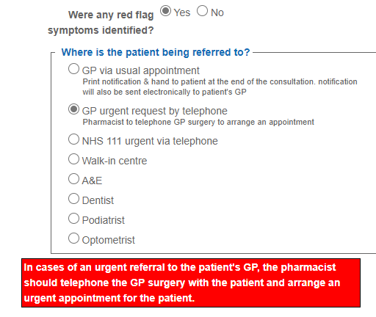
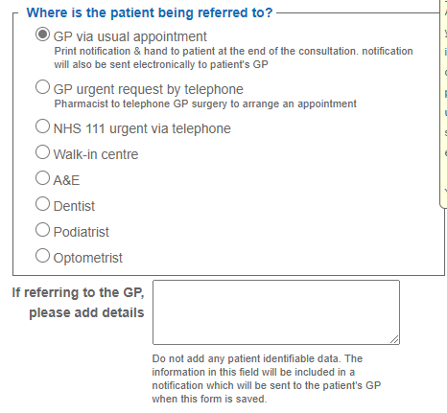
Supply (3) Red Flags
If red flag symptoms are noted, patient must be referred

Slide 6
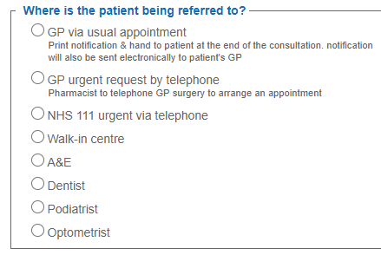
Supply (4) Other referral
If there are no red flags, you may still need to refer the patient
Select the appropriate option
For GP via usual appointment a notification is sent via nhs.net when you save the data

Slide 7
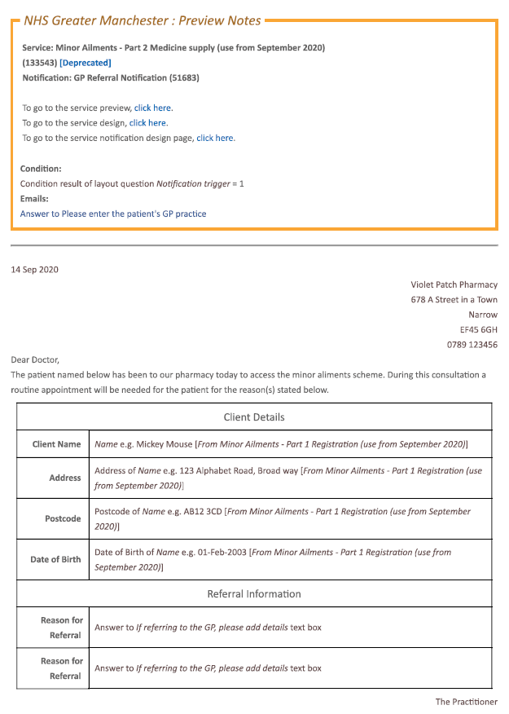
Supply (5) – GP referral
For ‘GP via usual appointment’ a notification is sent via nhs.net when you save the data
Example of the notification received by the GP:
Ensure the free type box contains pertinent and relevant info for the referral as it will be copied into this notification

Slide 8
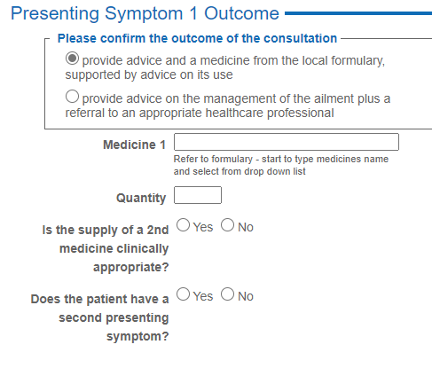
Supply (6) - Outcome
You can only select medicines from the formulary
Product may be listed as generic or brand
P/GSL packs only to be supplied (no POMs)
Quantity is number of doses
Pricing based on DM+D which is regularly updated by PharmOutcomes
Max 2 products per symptom (where clinically appropriate) – quantity as per formulary

Slide 9
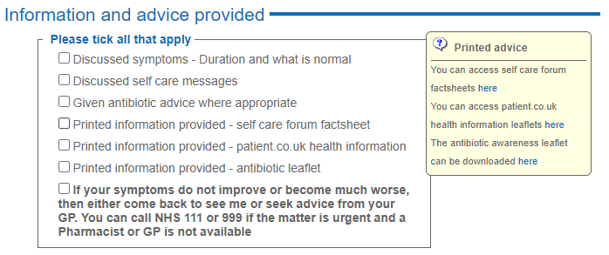
Supply (7) – Advice & Safety-netting
Can make a supply for 2 presenting conditions if required – enter same info as for the first presenting symptom
Product supply rules same as for first presenting symptom
Close the consultation by indicating the information and advice provided
Ensure appropriate safety-netting information is given to the patient

Slide 10
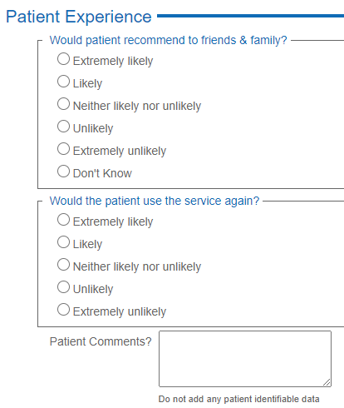
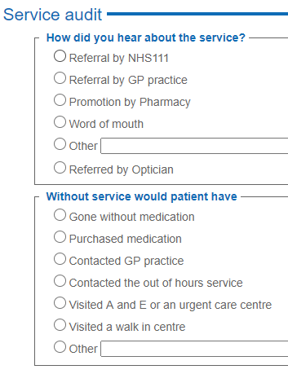
Supply (8) – Feedback
Complete service audit questions
Complete patient experience questions
Both are vital to provide evidence to demonstrate the requirement for this service to continue to be commissioned

